Slide 1
Computer Organisation
Topic 3
Computer Arithmetic
(Part 2)
Stallings, Computer Organization & Architecture (9th Ed.), Chap. 10

Slide 2




Outline
Arithmetic & Logic Unit
Integer Representation
Sign-magnitude
Twos complement
Conversion between lengths
Integer Arithmetic
Floating-point Arithmetic
Addition & Subtraction
Multiplication
Division

Slide 3
2’s complement operations
Addition
Subtraction
Multiplication
Division
Add-shift method (unsigned integer)
Booth’s algorithm (-ve numbers)

Slide 4
Multiplication
Compared with addition and subtraction, multiplication is a complex operation, whether performed in hardware or software.
A wide variety of algorithms have been used in various computers.
Work out partial product for each digit
Take care with place value (column)
Add partial products
Notes:
4

Slide 5
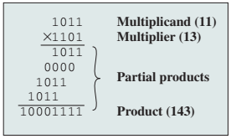
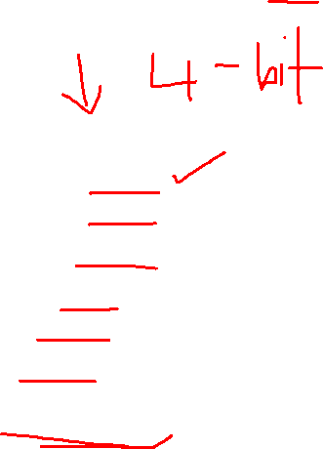
Multiplication of unsigned integer

Slide 6
11 x 13
Pencil and paper approach
11 = multiplicand
13 = multiplier
 |  |  |  |  | 1 | 0 | 1 | 1
 |  |  |  | X | 1 | 1 | 0 | 1
 |  |  |  |  | 1 | 0 | 1 | 1
 |  |  |  | 0 | 0 | 0 | 0 | x
 |  |  | 1 | 0 | 1 | 1 | x | x
 |  | 1 | 0 | 1 | 1 | x | x | x
 | 1 | 0 | 0 | 0 | 1 | 1 | 1 | 1
11
13
Partial products
Addition operation
Note:
if multiplier bit is 1 copy multiplicand (place value) otherwise zero
Need double length result
Notes:
Multiplication involves the generation of partial products, one for each digit in the multiplier. These partial products are then summed to produce the final product.
The partial products are easily defined. When the multiplier bit is 0, the partial product is 0. When the multiplier is 1, the partial product is the multiplicand
The total product is produced by summing the partial products. For this operation, each successive partial product is shifted one position to the left relative to the preceding partial product.

Slide 7
Multiplication
How can this be more efficient?
Perform running addition on partial products
Do not have to wait until the end
Fewer registers are needed
This eliminates the need for storage of all the partial products
Notes:
Compared with the pencil-and-paper approach, there are several things we can do to make computerized multiplication more efficient.

Slide 8
Multiplication
How can this be more efficient?
2. Save time on generation of partial products
For each 1 on multiplier requires an add and a shift operation
For each 0 on multiplier, only a shift is required

Slide 9
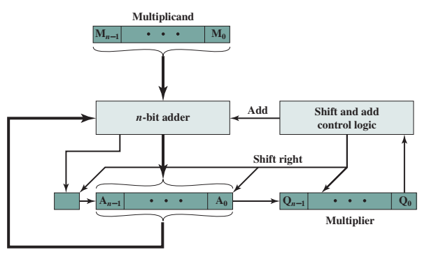

Multiplication block diagram
M: (11)₁₀
Q: (13)₁₀
A: (additional register)
C: Carry bit
Note:
M remains the same
C, A & Q involved in shifting
C
Notes:
This multiplication block diagram illustrate the concept of multiplication in the ALU
Multiplicand and multiplier are loaded into 2 registers (Q and M )
Next, the third register, A is needed to and initially set to 0
Then, we have a 1-bit register, C that was also initialized to 0 to hold the potential carry bit (for any addition process)
How did operations work?
CU read the Q register one bit at a time and if Q0 =1, the multiplicand is added to the A register and result will be stored to A. (C is required for carry bit or overflow cases)
Then, all of the bits of the C, A and Q registers are shifted to the right ONE bit so that C bit goes into A(n-1) , A0 goes into Q(n-1) and Q0 is lost
Then, no addition is performed, just the shift

Slide 10
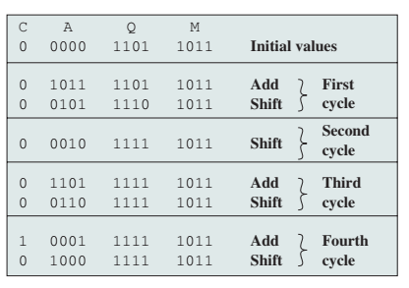

Unsigned Binary Multiplication
For each 1 on multiplier requires an add and a shift operation
For each 0 on multiplier, only a shift is required
M: Multiplicand = (11)₁₀
Q: Multiplier = (13)₁₀
A: (additional register)
C: Carry bit
Note:
M remains the same
C, A & Q involved in shifting

Slide 11
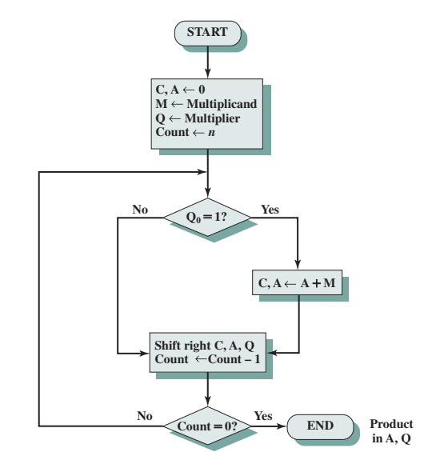

Flowchart for Unsigned Binary Multiplication

Slide 12
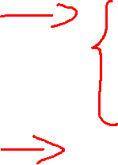
11 x 13
Pencil and paper approach
11 = multiplicand
13 = multiplier
 |  |  |  |  | 1 | 0 | 1 | 1
 |  |  |  | X | 1 | 1 | 0 | 1
 |  |  |  |  | 1 | 0 | 1 | 1
 |  |  |  | 0 | 0 | 0 | 0 | x
 |  |  | 1 | 0 | 1 | 1 | x | x
 |  | 1 | 0 | 1 | 1 | x | x | x
 | 1 | 0 | 0 | 0 | 1 | 1 | 1 | 1
11
13
Notes:
Multiplication involves the generation of partial products, one for each digit in the multiplier. These partial products are then summed to produce the final product.
The partial products are easily defined. When the multiplier bit is 0, the partial product is 0. When the multiplier is 1, the partial product is the multiplicand
The total product is produced by summing the partial products. For this operation, each successive partial product is shifted one position to the left relative to the preceding partial product.

Slide 13
0 + 0 = 0
0 + 1 = 1
1 + 0 = 1
1 + 1 = 0 carry forward 1
(11)₁₀ x (13)₁₀
(11)₁₀ = (1011)₂
(13)₁₀ = (1101)₂
1
0
1
1
1
1
0
1
1
0
1
1
1
1
0
0
0
0
1
1
0
1
1
1
0
1
1
1
0
0
0
1
1
1
1

Slide 14
0 + 0 = 0
0 + 1 = 1
1 + 0 = 1
1 + 1 = 0 carry forward 1
(13)₁₀ x (9)₁₀
(13)₁₀ = (1101)₂
(9)₁₀ = (1001)₂
1
1
0
1
1
0
0
1
1
1
1
0
1
0
0
0
0
0
0
0
0
1
1
0
1
= (117)₁₀
0
1
1
1
0
1
0
1

Slide 15
Multiplication using Add-shift method
11 x 13
11 = M (multiplicand)
13 = Q (multiplier)
143 = AQ

Slide 16
Multiplicand (M)
M_{n-1}
M_{n-2}
M₁
M₀
n-bit Adder
Shift and Add control logic
Shift Right
C
A_{n-1}
A_{n-2}
A₁
A₀
Q_{n-1}
Q_{n-2}
Q₁
Q₀
1 bit register
Register (A)
Multiplier (Q)
Hardware Structure for add-shift multiplication
Notes:
4 different registers – multiplicand(M), multiplier(Q), register (A) and Register (C)
Out of these 4 registers, (M), (A) and (Q) are n bit register – depending on the number of bit
C register is the 1-bit register to handle the overflow
N-bit adder to perform the n-bit addition process
Control logic = to perform the shift and addition process --- send signal to adder as well as registers

Slide 17
Initialize C, A to 0
Fill the (M) and (Q) with the binary value
Count = bit value
N cycle:
Check the Q₀ value
If 1 = Add value in (A) and (M)
Shift RIGHT (C), (A) and (Q)
Count – 1
If 0 = Shift RIGHT (C), (A) and (Q)
Count -1
Final cycle = count = 0

Slide 18
13 (M_{ultiplicand}) = 1101
11 (Q_{Multiplier}) = 1011
13 x 11
Expected results:
(143)₁₀
(10001111)₂
C | A | Q | Operation | Cycle
0 | 0000 | 1011 | Initial
0 0 | 1101 0110 | 1011 1101 | Add (A+M) Shift right | 1st
1 0 | 0110 1001 | 1101 1110 | Add (A+M) Shift right | 2nd
0 | 0100 | 1111 | Shift right | 3rd
1 0 | 0001 1000 | 1111 1111 | Add (A+M) Shift right | 4th
Shift count = bit count
Add count = 1 count in Q

Slide 19
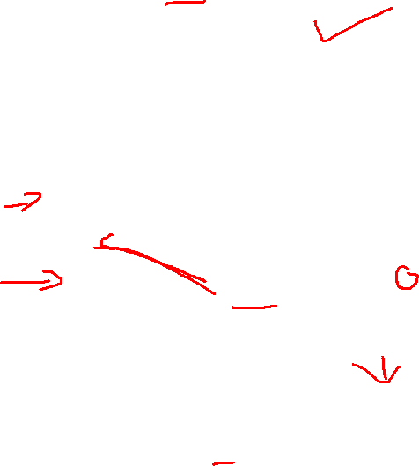
13 (M_{ultiplicand}) = 1101 (remain unchanged)
11 (Q_{Multiplier}) = 1011
13 x 11
Expected results:
(143)₁₀
(10001111)₂
n=4
C | A | Q | Operation | Cycle
0
0000
1 0 1 1
initialization
-
1101
Q₃
Q₂
Q₁
Q₀
0
0000
1101
1101
1
0
1
1
A+M
+
1st cycle
0
0
1
1
0
1
1
0
1
Shift → C, A & Q
0110
1101
10011
1
0011
1
1
0
1
+
A+M
2nd cycle
0
1001
1110
Shift → C, A & Q
0
0100
1111
Shift → C, A & Q
3rd cycle
0001
1
0100
1101
10001
1111
A+M
+
4th cycle
0
1000
1111
Shift → C, A & Q

Slide 20
12 x 14
Expected results:
(168)₁₀
(10101000)₂
12 (M_{ultiplicand}) = 1100
14 (Q_{Multiplier}) = 1110
C | A | Q | Operation | Cycle
0 | 0000 | 1110 | Initial
0 | 0000 | 0111 | Shift C, A &Q | 1st
0 0 | 1100 0110 | 0111 0011 | Add A+M Shift C, A &Q | 2nd
1 0 | 0010 1001 | 0011 0001 | Add A+M Shift C, A &Q | 3rd
1 0 | 0101 1010 | 0001 1000 | Add A+M Shift C, A &Q | 4th

Slide 21
Quick activity #7
Multiply the following values using add-shift multiplication method:
10 x 10
9 x 12

Slide 22
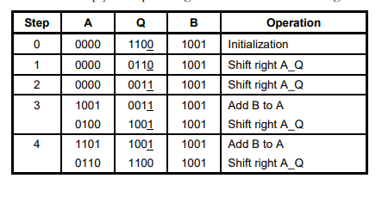

Slide 23
How we handle multiplication of two negative numbers?

Slide 24
Multiplying Negative Numbers (2s Complement)
1011
Multiplicand (-5 decimal)
x
1101
Multiplier (-3 decimal)
1011
0000
1011
Partial products
1011
Product (?? decimal)
10001111
Notes:
24

Slide 25
Multiplying Negative Numbers (2s Complement)
1011
Multiplicand (-5 decimal)
x
1101
Multiplier (-3 decimal)
1011
0000
Partial products
1011
1011
10001111
Product (-113 decimal)
Notes:
25
If the multiplier is negative, straightforward multiplication also will not work.
The reason is that the bits of the multiplier no longer correspond to the shifts or multiplications that must take place.

Slide 26
Multiplying Negative Numbers (2s Complement)
Solution 1
Convert to positive if required
Multiply as above
If signs were different, negate answer
Implementers prefer techniques that do not require this final transformation step

Slide 27
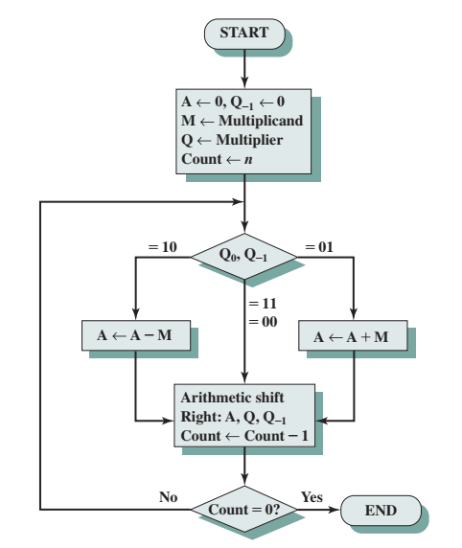
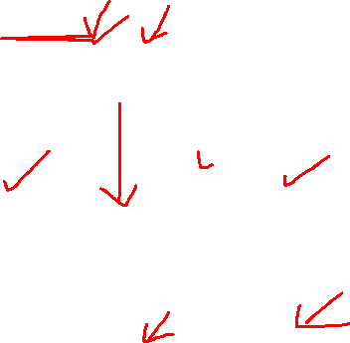
Multiplying Negative Numbers (2s Complement)
Solution 2
Booth’s algorithm
Multiplies two signed binary numbers in 2s complement notation
Invented by Andrew Donald Booth in 1950s
Notes:
One of the most common of these is Booth’s algorithm. This algorithm also has the benefit of speeding up the multiplication process, relative to a more straightforward approach.

Slide 28
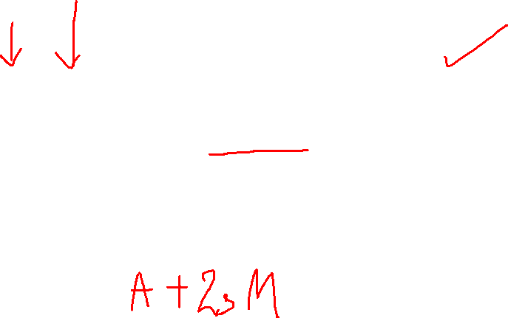
Booth’s Algorithm conditions
Q₃Q₂Q₁Q₀Q₋₁
Q₀ | Q₋₁ | Operation
0 | 0 | Shift right A, Q, Q₋₁
1 | 1
0 | 1 | Add (A+M) Shift right A, Q, Q₋₁
1 | 0 | Subtract (A-M) Shift right A, Q, Q₋₁
Notes:
Q₋₁ =1-bit register placed logically to the right of the least significant bit (Q0) of the Q register
control logic scans the bits of the multiplier one at a time.
Now, as each bit is examined, the bit to its right is also examined.
If the two bits are the same (1–1 or 0–0), then all of the bits of the A, Q, and Q-1 registers are shifted to the right 1 bit.
If the two bits differ, then the multiplicand is added to or subtracted from the A register, depending on whether the two bits are 0–1 or 1–0.
Following the addition or subtraction, the right shift occurs.
In either case, the right shift is such that the leftmost bit of A, namely An - 1, not only is shifted into An - 2, but also remains in An - 1.
This is required to preserve the sign of the number in A and Q.
It is known as an arithmetic shift, because it preserves the sign bit.

Slide 29
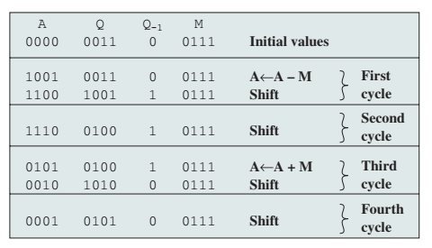

Booth’s algorithm
7 x 3
Expected results:
(21)₁₀
(10101)₂
7 (M_{ultiplicand}) = 0111(remain unchanged)
3 (Q_{Multiplier}) = 0011

Slide 30
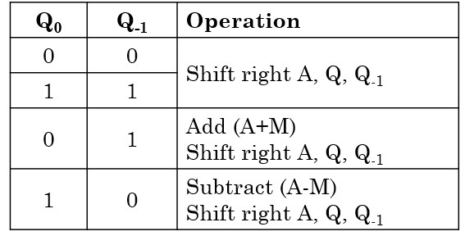
Booth’s algorithm
7 x 3
Expected results:
(21)₁₀
(10101)₂
7 (M_{ultiplicand}) = 0111(remain unchanged)
3 (Q_{Multiplier}) = 0011
1
0
1
1
0
0
0
1
Notes:
Rule 1: Find 2’s complement of the subtracted number
Rule 2: Perform the addition

Slide 31
Booth’s Algorithm
Example 2

Slide 32
7 (M_{ultiplicand}) = 0111
-6 (Q_{Multiplier}) = 1010
2s M = 1001
A | Q | Q₋₁ | M | Operation | Cycle
0000
1010
0
0111
Initialize
0000
0101
0
0111
Shift
1st cycle
1001
0101
0
0111
A-M = A+2sM
2nd cycle
1100
1010
1
0111
Shift
0011
1010
1
0111
A+M
3rd cycle
0001
1101
0
0111
Shift
1010
1101
0
0111
A-M = A+2sM
4th cycle
1101
0110
1
0111
Shift

Slide 33
Booth’s Algorithm
Example 3

Slide 34
Case 1: 4 x 4
M = 4 = 0100
Q = 4 = 0100
2s M = 1100
A | Q | Q₋₁ | Operation | Cycle
0000
0100
0
Init.
0
Shift
_000
0010
0
0000
0001
0
Shift
1100
0001
0
A-M
0000
1100
1100
1
1
_110
0000
Shift
0010
0000
1
A+M
1110
0100
10010
0001
0000
0
Shift

Slide 35
Case 1: 4 x -4
M = 4 = 0100
Q = -4 = 1100
2s M = 1100
2s Q = 0100
A | Q | Q₋₁ | Operation | Cycle
0000
1100
0
Init.
0000
0110
0
Shift
0000
0011
0
Shift
1100
0011
0
A-M
0000
1100
1100
1110
0001
1
Shift
1111
0000
1
Shift

Slide 36
Case 1: -4 x 4
M = -4 = 1100
Q = 4 = 0100
2s M = 0100
A | Q | Q₋₁ | Operation | Cycle
0000
0100
0
Init.
0000
0010
0
Shift
0000
0001
0
Shift
0100
0001
0
A-M
0000
0100
0100
0010
0000
1
Shift
1110
0000
1
A+M
0010
1100
1110
1111
0000
0
Shift

Slide 37
Case 1: -4 x -4
M = -4 = 1100
Q = -4 = 1100
2s M = 0100
2s Q = 0100
A | Q | Q₋₁ | Operation | Cycle
0000
1100
0
Init.
0000
0110
0
Shift
0000
0011
0
Shift
0100
0011
0
A-M
0000
0100
0100
0010
0001
1
Shift
0001
0000
1
Shift

Slide 38
Advantages of Booth’s Algorithm
Performed signed multiplications
Performs better of –ve numbers are involved
Reduced number of operations

Slide 39
Quick activity #8
Use the Booth algorithm to multiply 23 (multiplicand) by 29 (multiplier), where each number is represented using 6 bits
Use the Booth algorithm to multiply 10 (multiplicand) by -10 (multiplier), where each number is represented using 5 bits
Use the Booth algorithm to multiply -6 (multiplicand) by -5 (multiplier), where each number is represented using 4 bits
Use the Booth algorithm to multiply -7 (multiplicand) by 5(multiplier), where each number is represented using 4 bits
Given x = 0100 and y = 1100 in twos complement notation (i.e., x = 4, y = -4), compute the product p = x * y with Booth’s algorithm

Slide 40
2’s complement operations
Addition
Subtraction
Multiplication
Division

Slide 41
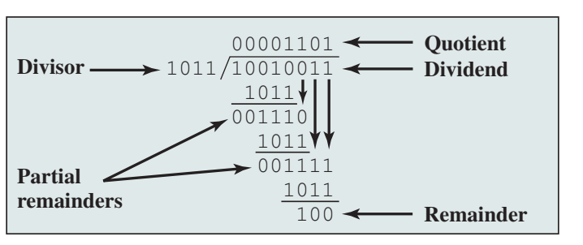
Division
Division is somewhat more complex than multiplication but is based on the same general principles.
As before, the basis for the algorithm is the paper-and-pencil approach, and the operation involves repetitive shifting and addition or subtraction.
Notes:
41

Slide 42
Long method division
0
1
6
Dividend (M) = 128
Divisor (Q) = 8
8
1
2
8
-
0
1<8
1
2
12>8
Quotient (or Answer) = 16
Remainder = 0
8
48>8
4
8
4
8
0

Slide 43
Long method division
0
Dividend (M) = 101010
Divisor (Q) = 110
(42)₁₀
0
0
1
1
1
(6)₁₀
1
1
0
1
0
1
0
1
0
-
0
1<110
1
0
10<110
-
0
101<110
Quotient (or Answer) = 111
Remainder = 0
1
0
1
1010>110
-
0
1001>110
1
110<110
1
0
1
0
-
1
1
0
-
1
0
0
1
1
1
0
0
1
1
0
-
1
1
0
0

Slide 44
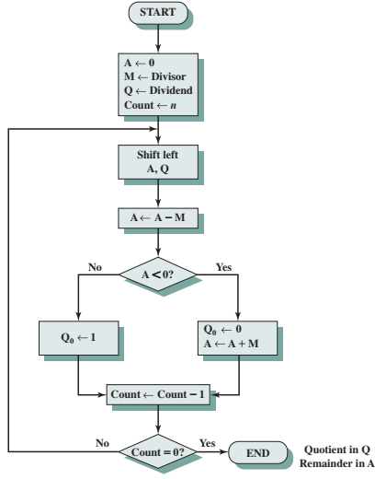
Flowchart for Unsigned Binary Division
Initial A register, Load M&Q register
Shift left (A & Q)
A – M operation
Look at A condition:
A<0 = T = Q₀ gets a 1 bit
A<0 = F = Q₀ gets a 0 bit and restores M the previous value

Slide 45
Division in 2s complement
7 ÷ 3 = 2 with 1 remainder (Q ÷ M)
Q = 0111
M = 0011
(3)
0011
0111
(7)
011
0001
0000
0001

Slide 46
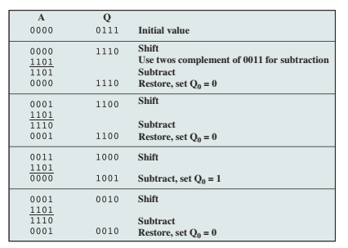
2sM =1101
(-3)
(-1)
(0)
(-1)

Slide 47
Q (Dividend) = 7 = 0111 M (Divisor) = 3 = 0011 2sM = 1101
A | Q | Operation
0000
0111
Init.
0
0000
111_
Shift (L)
0000
1101
1101
(-3)
1101
A-M
0000
1110
Restore A, Q₀ = 0
0001
0
0001
1101
1110
110_
Shift (L)
(-1)
1110
A-M
0001
1100
Restore A, Q₀ = 0
0011
100_
0
Shift (L)
0011
1101
10000
(0)
0000
A-M
0000
1001
Subtract, Q₀ = 1
0001
0
001_
Shift (L)
0001
1101
1110
(-1)
1110
A-M
0001
0010
Restore A, Q₀ = 0

Slide 48
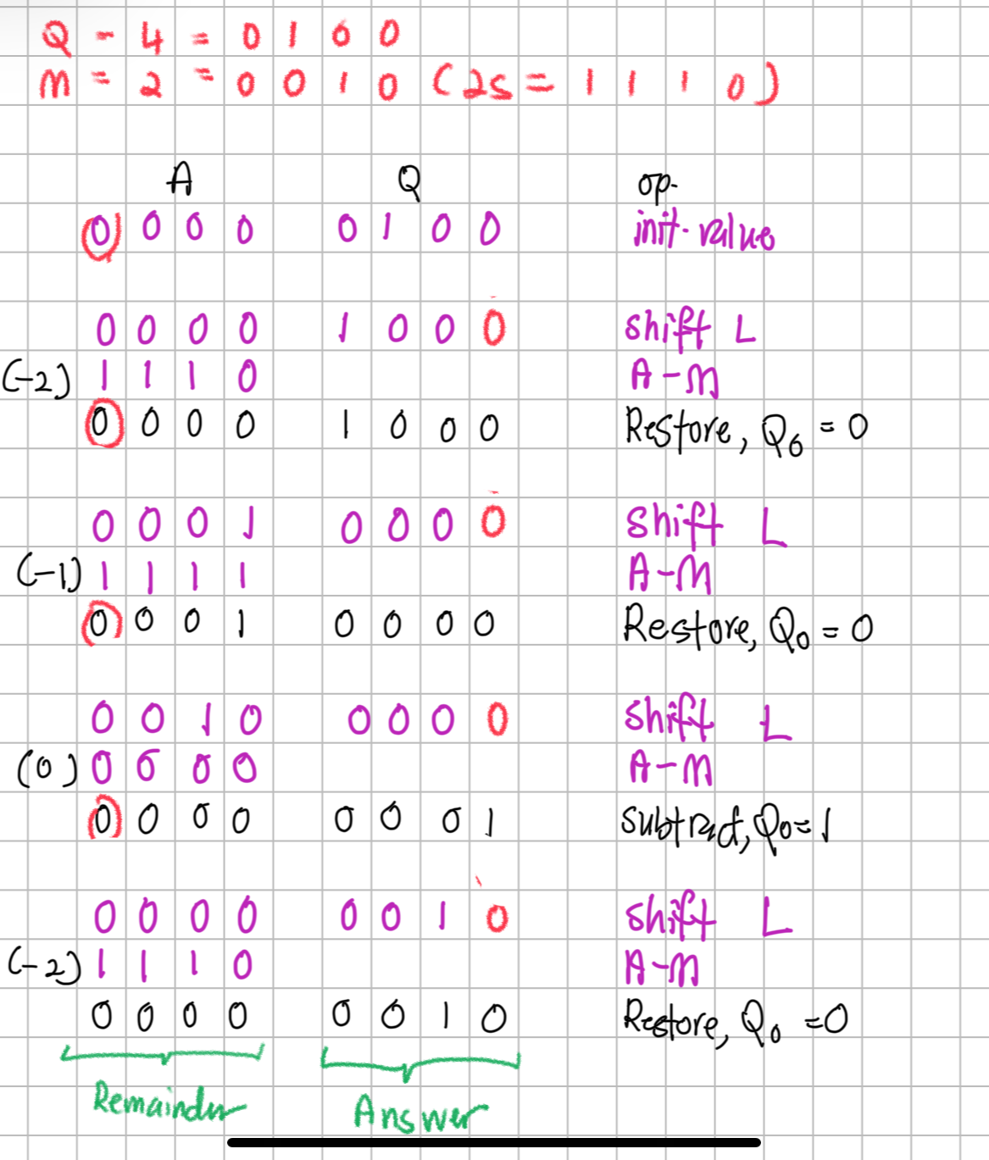

Slide 50
Quick activity #9
Execute the division for the following binary numbers using the long division method and restoring 2s complement division. You must show the full complete process side by side.
4 ÷ 2
9 ÷ 3
10 ÷ 4
11 ÷ 3

Slide 51
Outline
Arithmetic & Logic Unit
Integer Representation
Sign-magnitude
Twos complement
Conversion between lengths
Integer Arithmetic
Floating-point Arithmetic
Addition & Subtraction
Multiplication
Division

Slide 52
Introduction
Numbers
Fixed point
Floating point
Integers 1,21, 456
Fractions
0.5, 0.25, 0.123
1.52
15.2
456.123
Notes:
With a fixed-point notation (e.g., twos complement) it is possible to represent a range of positive and negative integers centered on or near 0. By assuming a fixed binary or radix point, this format allows the representation of numbers with a fractional component as well.

Slide 53
Real numbers
Numbers with fractions
Could be done in pure binary
E.g.:
1001.1010 = 2³ + 2⁰ + 2⁻¹ + 2⁻³ = 9.625
Notes:
Very often when we deal with numbers, we not only deal with integers, but we also deals with real numbers, numbers that are in fractions….
Very often this could be done in pure binary…
So binary numbers can also be used to represent real numbers as well….

Slide 54
Real numbers
With a fixed-point notation (e.g., twos complement) it is possible to represent a range of positive and negative integers centered on or near 0.
HOWEVER, this approach has limitations
Cannot represent a very LARGE numbers nor very SMALL fractions.
For decimals, we overcome this limitation by using scientific notation
976,000,000,000,000
9.76 x 10¹⁴
0.0000000000000976
9.76 x 10⁻¹⁴
Notes:
What we have done, in effect, is dynamically to slide the decimal point to a convenient location and use the exponent of 10 to keep track of that decimal point.
This allows a range of very large and very small numbers to be represented with only a few digits.

Slide 55
Real numbers
Where is the binary or radix point?
Fixed?
Very limited
Moving?
How do we show where it is?
Notes:
If you fixed the radix point, you will have limitation in representing the fractions for either larger or smallest number
If you want it to move, how do you show where the fraction starts?

Slide 56
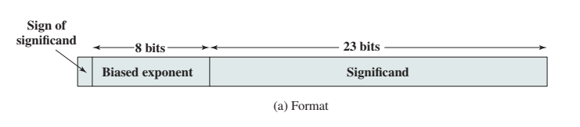
Floating-point representation
What about binary numbers?
± S x B ^{±E}
Sign: plus, or minus
Significand S
Exponent E
Notes:
So, one way to store floating point is to have it in a particular format

Slide 57
Signs for Floating Point
Significand is stored in 2s complement
Exponent is in biased notation
e.g. Bias of 127 means (2^{k-1} – 1), k is number of bits
8-bit exponent field
Pure value range 0-255
Range -127 to +128
Subtract 127 to get the correct value
Notes:
57

Slide 58
Floating-point representation
8 bits
23 bits
Biased Exponent
Significand
32 bits
Sign of number
(0=+ | 1=-)
Exponent value is stored in the next 8 bits
fractional part of a number
1.6328125 x 2²⁰
=
1.101001 x 2¹⁰¹⁰⁰
Notes:
1.6328125 x 2²⁰
How do we express this numbers in binary?

Slide 59
Floating-point representation
1.6328125 x 2²⁰
=
1.101001 x 2¹⁰¹⁰⁰
1. The original value of exponent = 20
2. To get the exponent value in binary = original exponent + bias exponent
20 + 127 = 147 → 10010011
3. The biased exponent value is = 10010011
10010011
S
Biased Exponent
Significand
Notes:
The original value of exponent is 20, and one of the way to represent the floating point numbers is using the biased exponent
In this case, the biased exponent is kept in 8 bit and the biased exponent for 8-bit is 127
How do we get the exponent value in binary?

Slide 60
Floating-point representation
1.6328125 x 2²⁰
=
1.1010001 x 2¹⁰¹⁰⁰
10010011
10100010000000000000000
S
Biased Exponent
Significand
How do we get the significand value?
2. Convert the fractional portion to binary
0.6328125 to binary = 101001
3. Therefore, the significand is 101001 + remaining 0 to fulfil 23 bits
Notes:
Now, how do we get the significand value?
In this case, the biased exponent is kept in 8 bit and the biased exponent for 8-bit is 127
How do we get the exponent value in binary?

Slide 61
Floating-point representation
1.6328125 x 2²⁰
=
1.1010001 x 2¹⁰¹⁰⁰
0
10010011
10100010000000000000000
S
Biased Exponent
Significand
How do we identify the sign value?
0 = (+) and 1 (-)
Notes:
Now, how do we get the significand value?
In this case, the biased exponent is kept in 8 bit and the biased exponent for 8-bit is 127
How do we get the exponent value in binary?

Slide 62
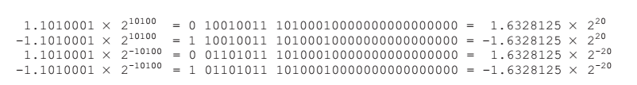
Floating-point representation
Tip: 20 + 127 = 147
Tip: -20 + 127 = 107
2⁷ | 2⁶ | 2⁵ | 2⁴ | 2³ | 2² | 2¹ | 2⁰
128 | 64 | 32 | 16 | 8 | 4 | 2 | 1
0 | 1 | 1 | 0 | 1 | 0 | 1 | 1

Slide 63
Normalization
Floating point numbers are usually normalized
i.e. exponent is adjusted so that leading bit (MSB) of significand is 1
Since it is always 1 there is no need to store it
23 bits can store 24-bit number
c.f. Scientific notation where numbers are normalized to give a single digit before the decimal point
e.g. 3.123 x 10³
Notes:
63
To simplify operations on floating-point numbers, it is typically required that they be normalized.

Slide 64
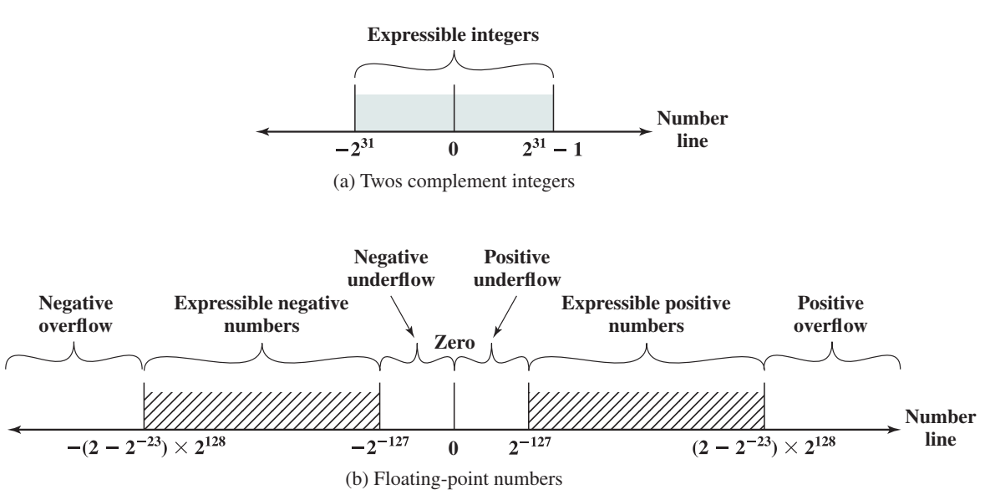
Expressible Numbers
2,147,483,647
-2,147,483,647
(32 bits)
1.0… x
1.111… =
The biggest (+) number can be represented
The smallest (+) number can be represented
(1 sign bit, 8 bit exponent, 23-bit significand)

Slide 65
IEEE 754
The most important floating-point representation is defined in IEEE Standard 754, adopted in 1985 and revised in 2008.
This standard was developed to facilitate the portability of programs from one processor to another and to encourage the development of sophisticated, numerically oriented programs.
The standard has been widely adopted and is used on virtually all contemporary processors and arithmetic coprocessors. IEEE 754-2008 covers both binary and decimal floating-point representations.
Standard for floating point storage
32- 64- and 128-bit standards
8, 11 and 15-bit exponent respectively
Extended formats (both significand and exponent) for intermediate results
Notes:
65

Slide 66
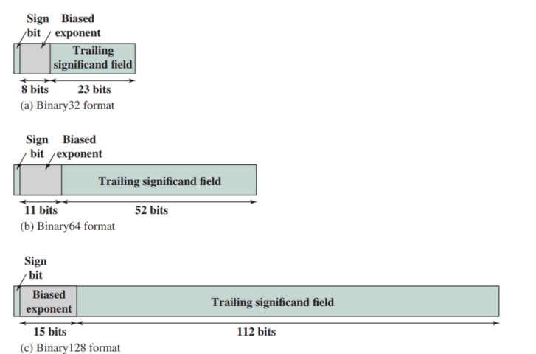
IEEE 754

Slide 67
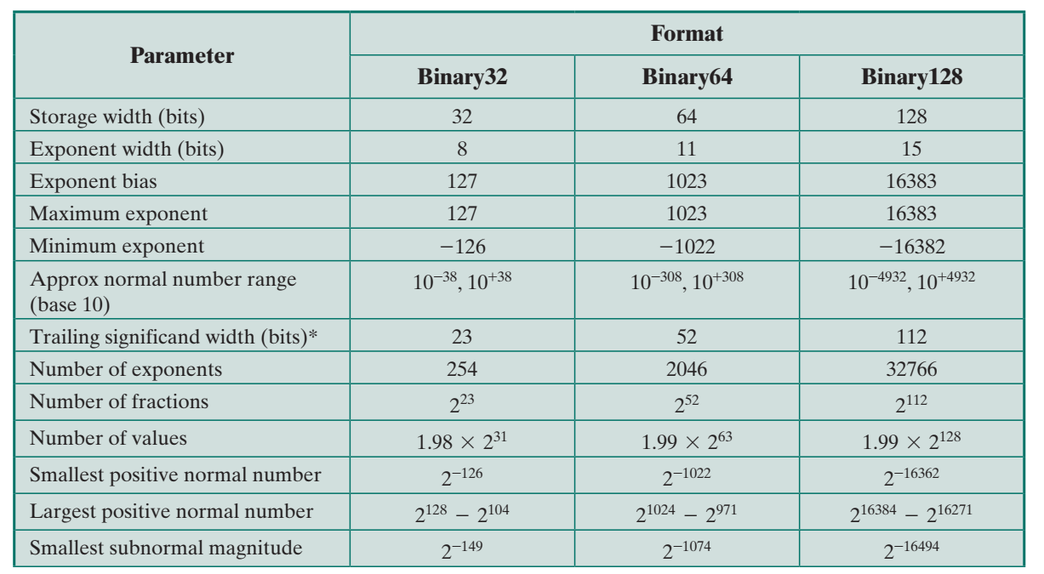

Slide 68
Floating Point Arithmetic
FP operation may cause
Exponent overflow
Positive exponent exceed maximum possible value
May be + ∞ or - ∞
Exponent underflow
Negative exponent less than the minimum possible
Number too small, may be reported as 0
Significand underflow
When aligning, digits flow off the right end of significand
Significand overflow
Carry out of most significant bit
E.g. when adding 2 significand of same sign

Slide 69
FP Arithmetic Addition/Subtraction
More complicated than multiplication/division
Need for alignment
4 phases
Check for zeros
Align significands (adjusting exponents)
Add or subtract significands
Normalize result
Notes:
69

Slide 70
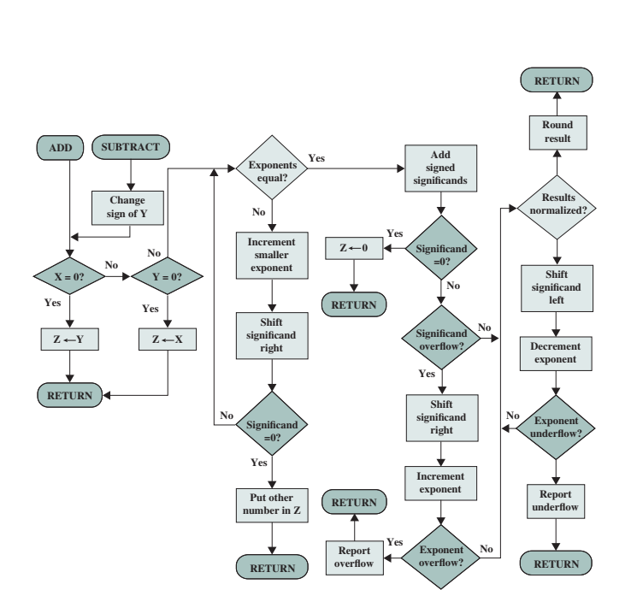
FP Addition & Subtraction Flowchart

Slide 71
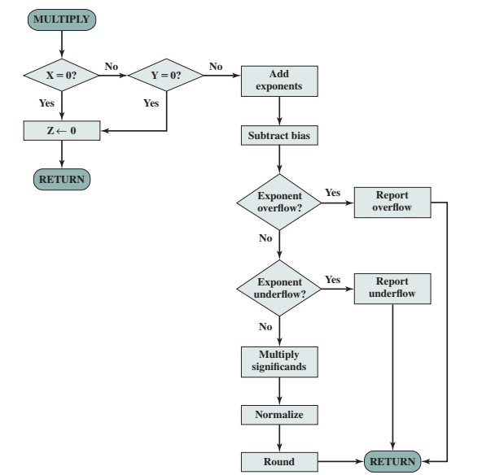
FP Multiplication Flowchart

Slide 72
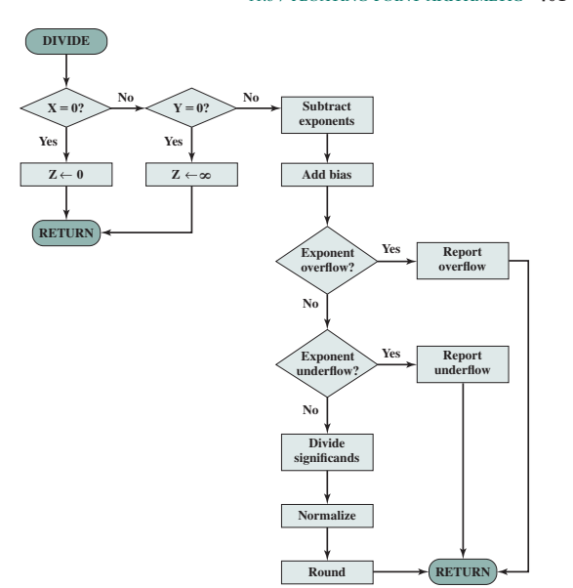
FP Division Flowchart

Slide 73
Quick Activity #10
The following numbers use the IEEE 32-bit floating-point format. What is the equivalent decimal value?
0 10000000 10100000000000000000000
1 10000010 00100000000000000000000

Slide 74
Quick Activity #11
Express the following numbers in IEEE 32-bit floating-point format
-5
-6
384
1/16

Slide 75
Quick Activity #11
Express the following numbers in IEEE 32-bit floating-point format
-5
1
01111111
01000000000000000000000
S
Biased Exponent
Significand
Determine the sign bit
Convert the integer to binary value
Determine the exponent
For 32-bit floating point, we will be using 8-bit biased exponent
Determine the significand
Notes:
Significand is the fractional portion, the component of a floating-point representation
How do we determine the significand for 5?
Normalize the binary fraction, in this case of 5, the binary value is 101, and normalization is when the MSB is set to 1 so that we do not have to store the value
In this case of 5, the MSB is 1 and no changes is made to the binary value
Therefore, the significand for 5 is 01.

Slide 76

Reflection…
From the lecture today, I learnt……
Link on eLearn / Chat
Image source: https://www.flickr.com/photos/29143375@N05/4582236533

